Slide 1



Slide 2

Presentation Overview
2011-2013
Context
of Social Change
2013-2016
Inception Process
2016-2018
Consolidation
Process
2018-2023
Continuity Plan

Slide 3
Presentation Overview
2011-2013
Context
of Social Change
2013-2016
Inception Process
2016-2018
Consolidation
Process
2018-2023
Continuity Plan

Slide 4
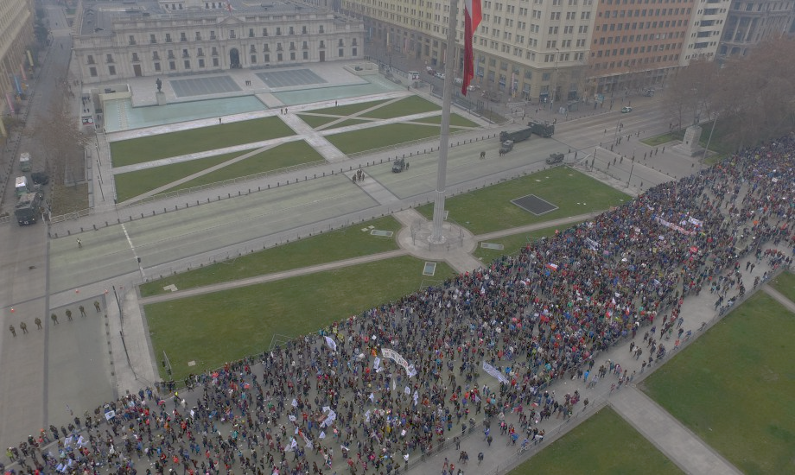
Chilean context
Now a high/middle income country
High inequality and segregation, low social mobility
Social, cultural and political transition after 1990
Accelerated social change after 2000
Social movements, lack of trust in political institutions
Prompt political and structural reforms
Notes:
Mencionaría también al principio el retorno a la democracia luego de una dictadura caracterizada por neoliberal reforms y violaciones a los derechos humanos
4

Slide 5
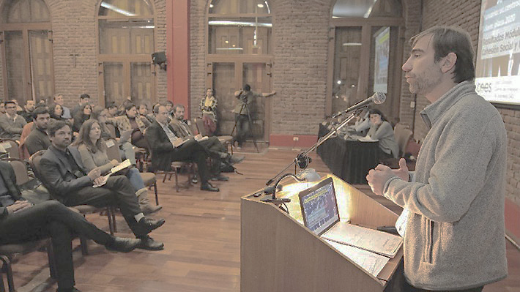
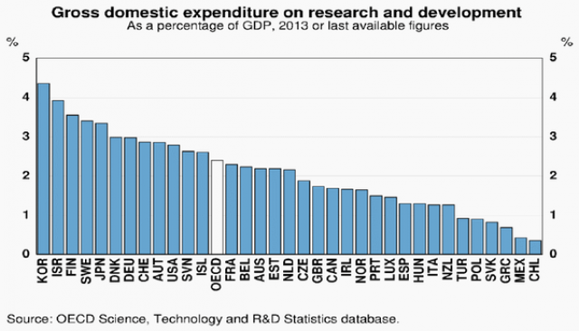
Chilean academic context
Social Sciences were repressed during dictatorship 1973-1990
No tradition of publications in academic journals
Incipient doctoral programmes
Atomised academic communitites
COES researchers have to continue
with their regular academic activities
Notes:
- mencionar el cierre de varias escuelas de ciencias sociales en las universidades
- y una cosa de contexto más general: el gráfico de inversión en ciencia como porcentaje del PIB comparando a Chile con OECD, ese es muy bueno para partir.
5

Slide 6
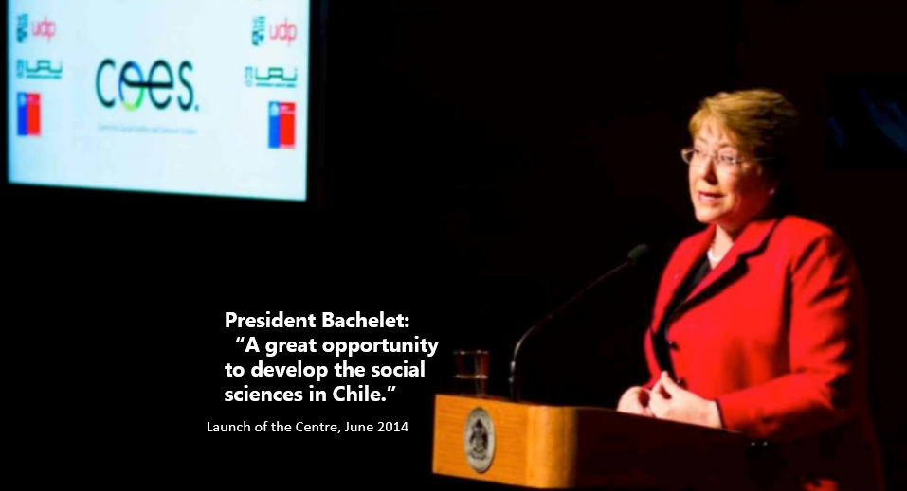

Slide 7
Presentation Overview
2011-2013
Context
of Social Change
2013-2016
Inception Process
2016-2018
Consolidation
Process
2018-2023
Continuity Plan

Slide 8
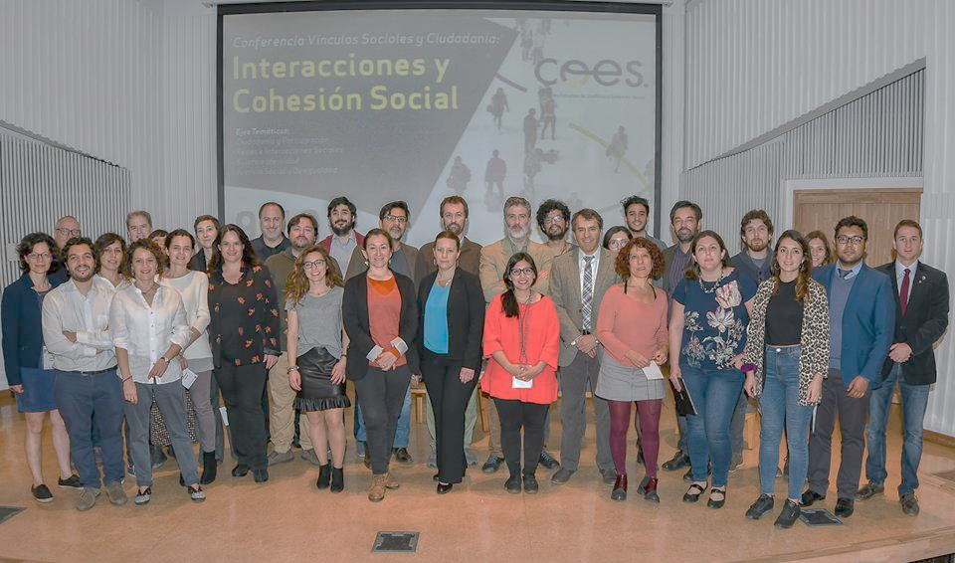
The Centre: Initial conditions
Group of 26 disconnected researchers.
Our group grew through new postdocs, new hires (in Universities)
As a result we built a more dense network of researchers.
First building up research lines.
Then across lines.

Slide 9
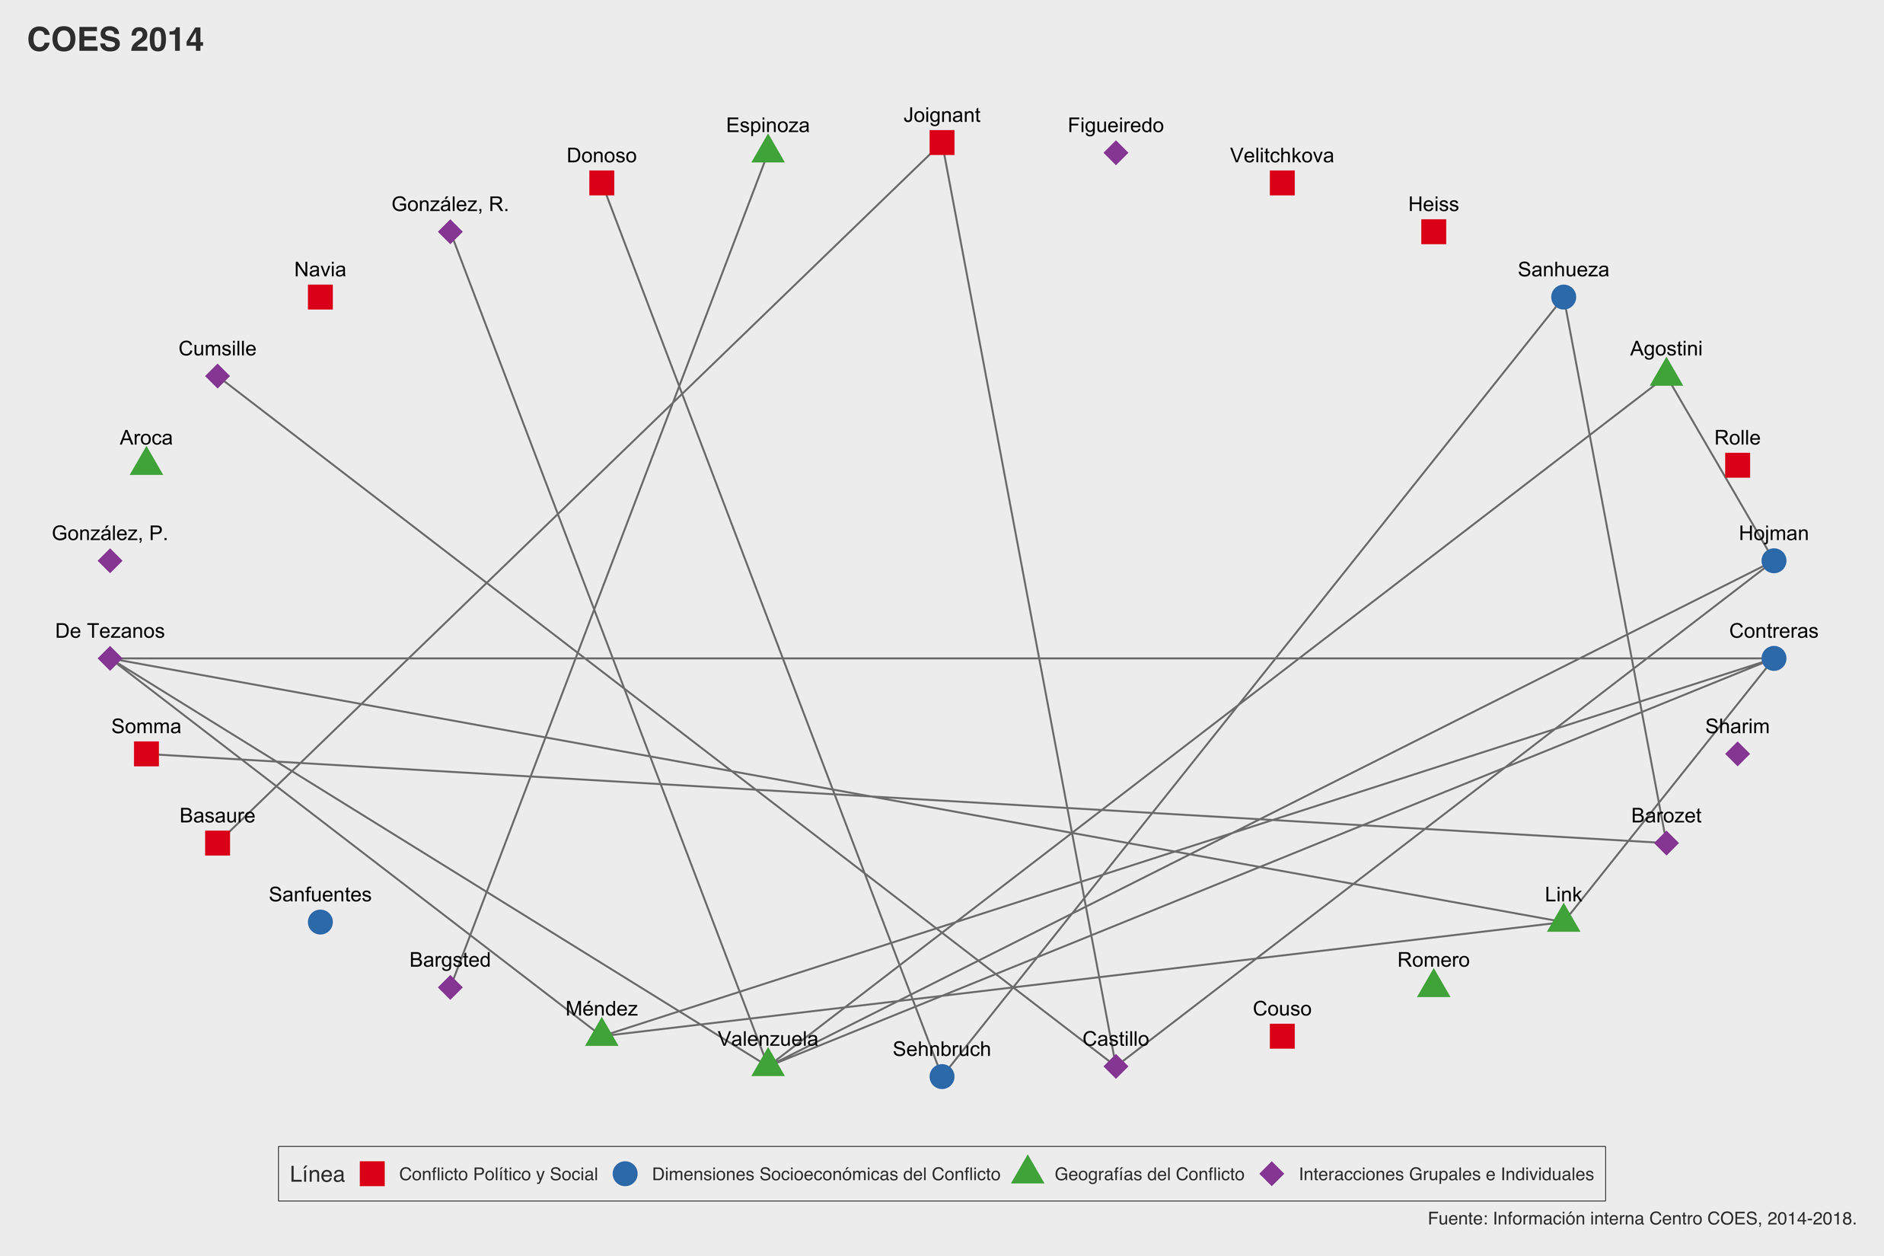
2014
30 Researchers
41 interconnections
Social and Political Conflict
Socioeconomic Dimensions of Conflict
Geographies of Conflict
Group and Individual Interactions

Slide 10
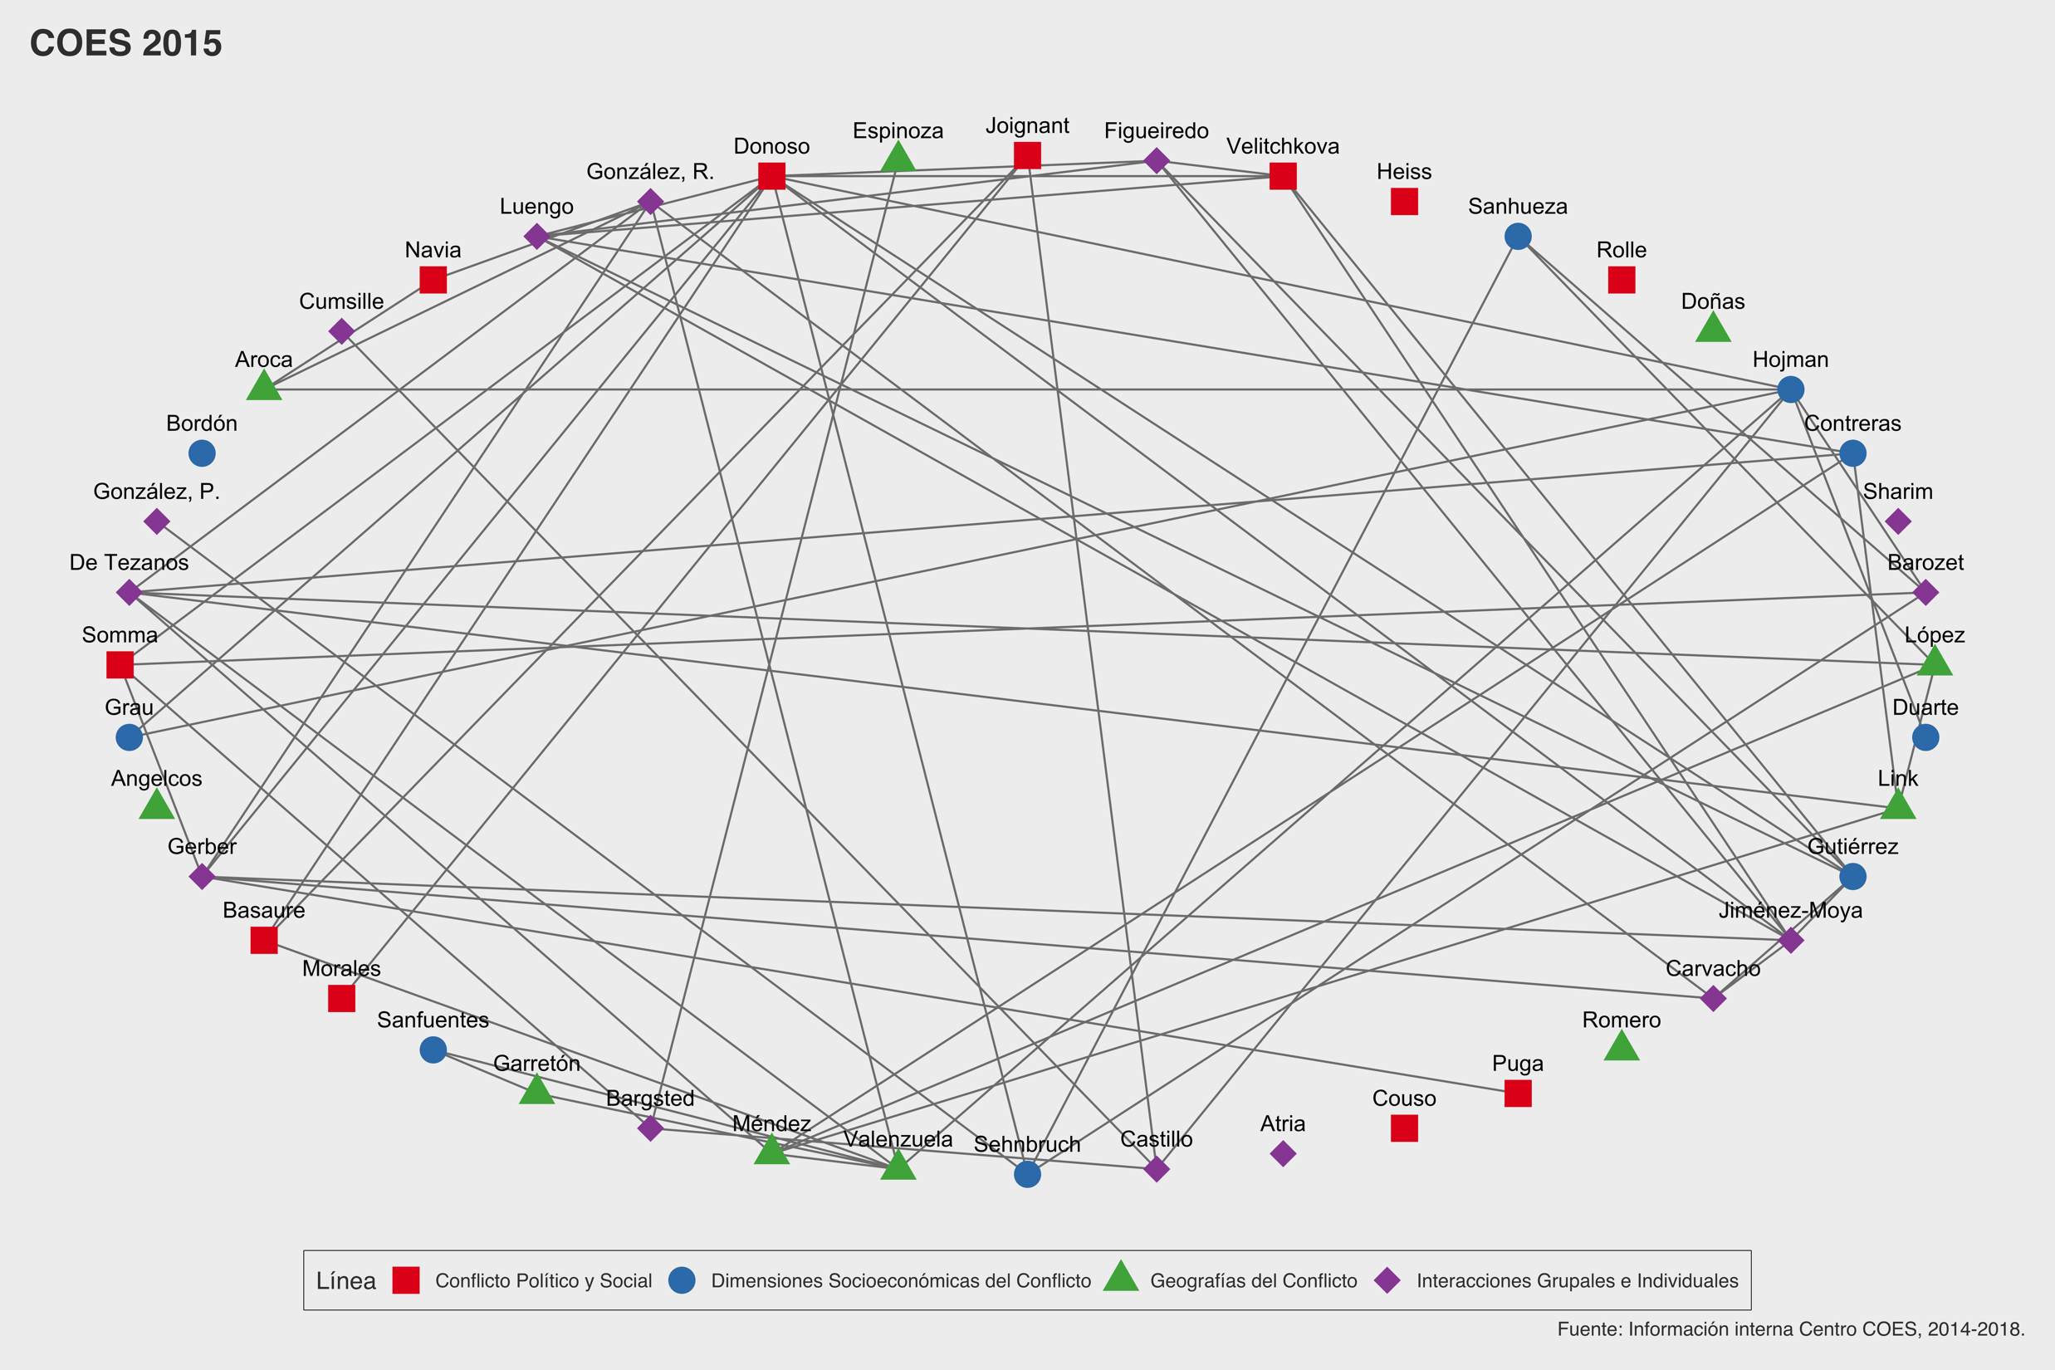
2015
44 Researchers
133 interconnections
Social and Political Conflict
Socioeconomic Dimensions of Conflict
Geographies of Conflict
Group and Individual Interactions

Slide 11
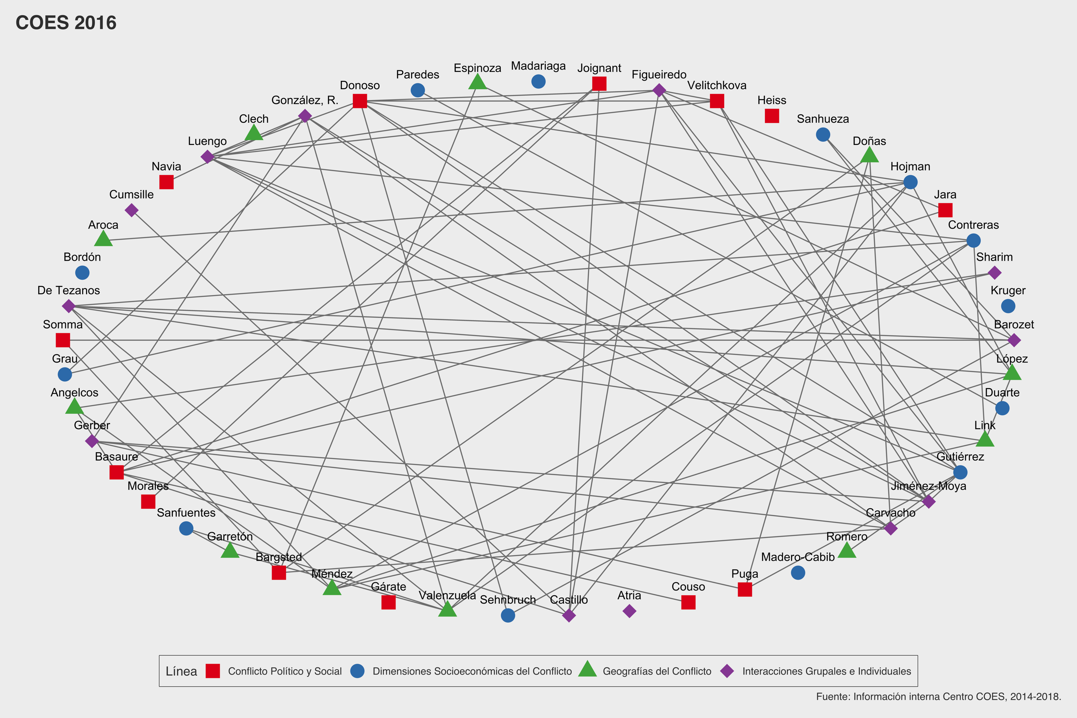
2016
49 Researchers
148 interconnections
Social and Political Conflict
Socioeconomic Dimensions of Conflict
Geographies of Conflict
Group and Individual Interactions

Slide 12
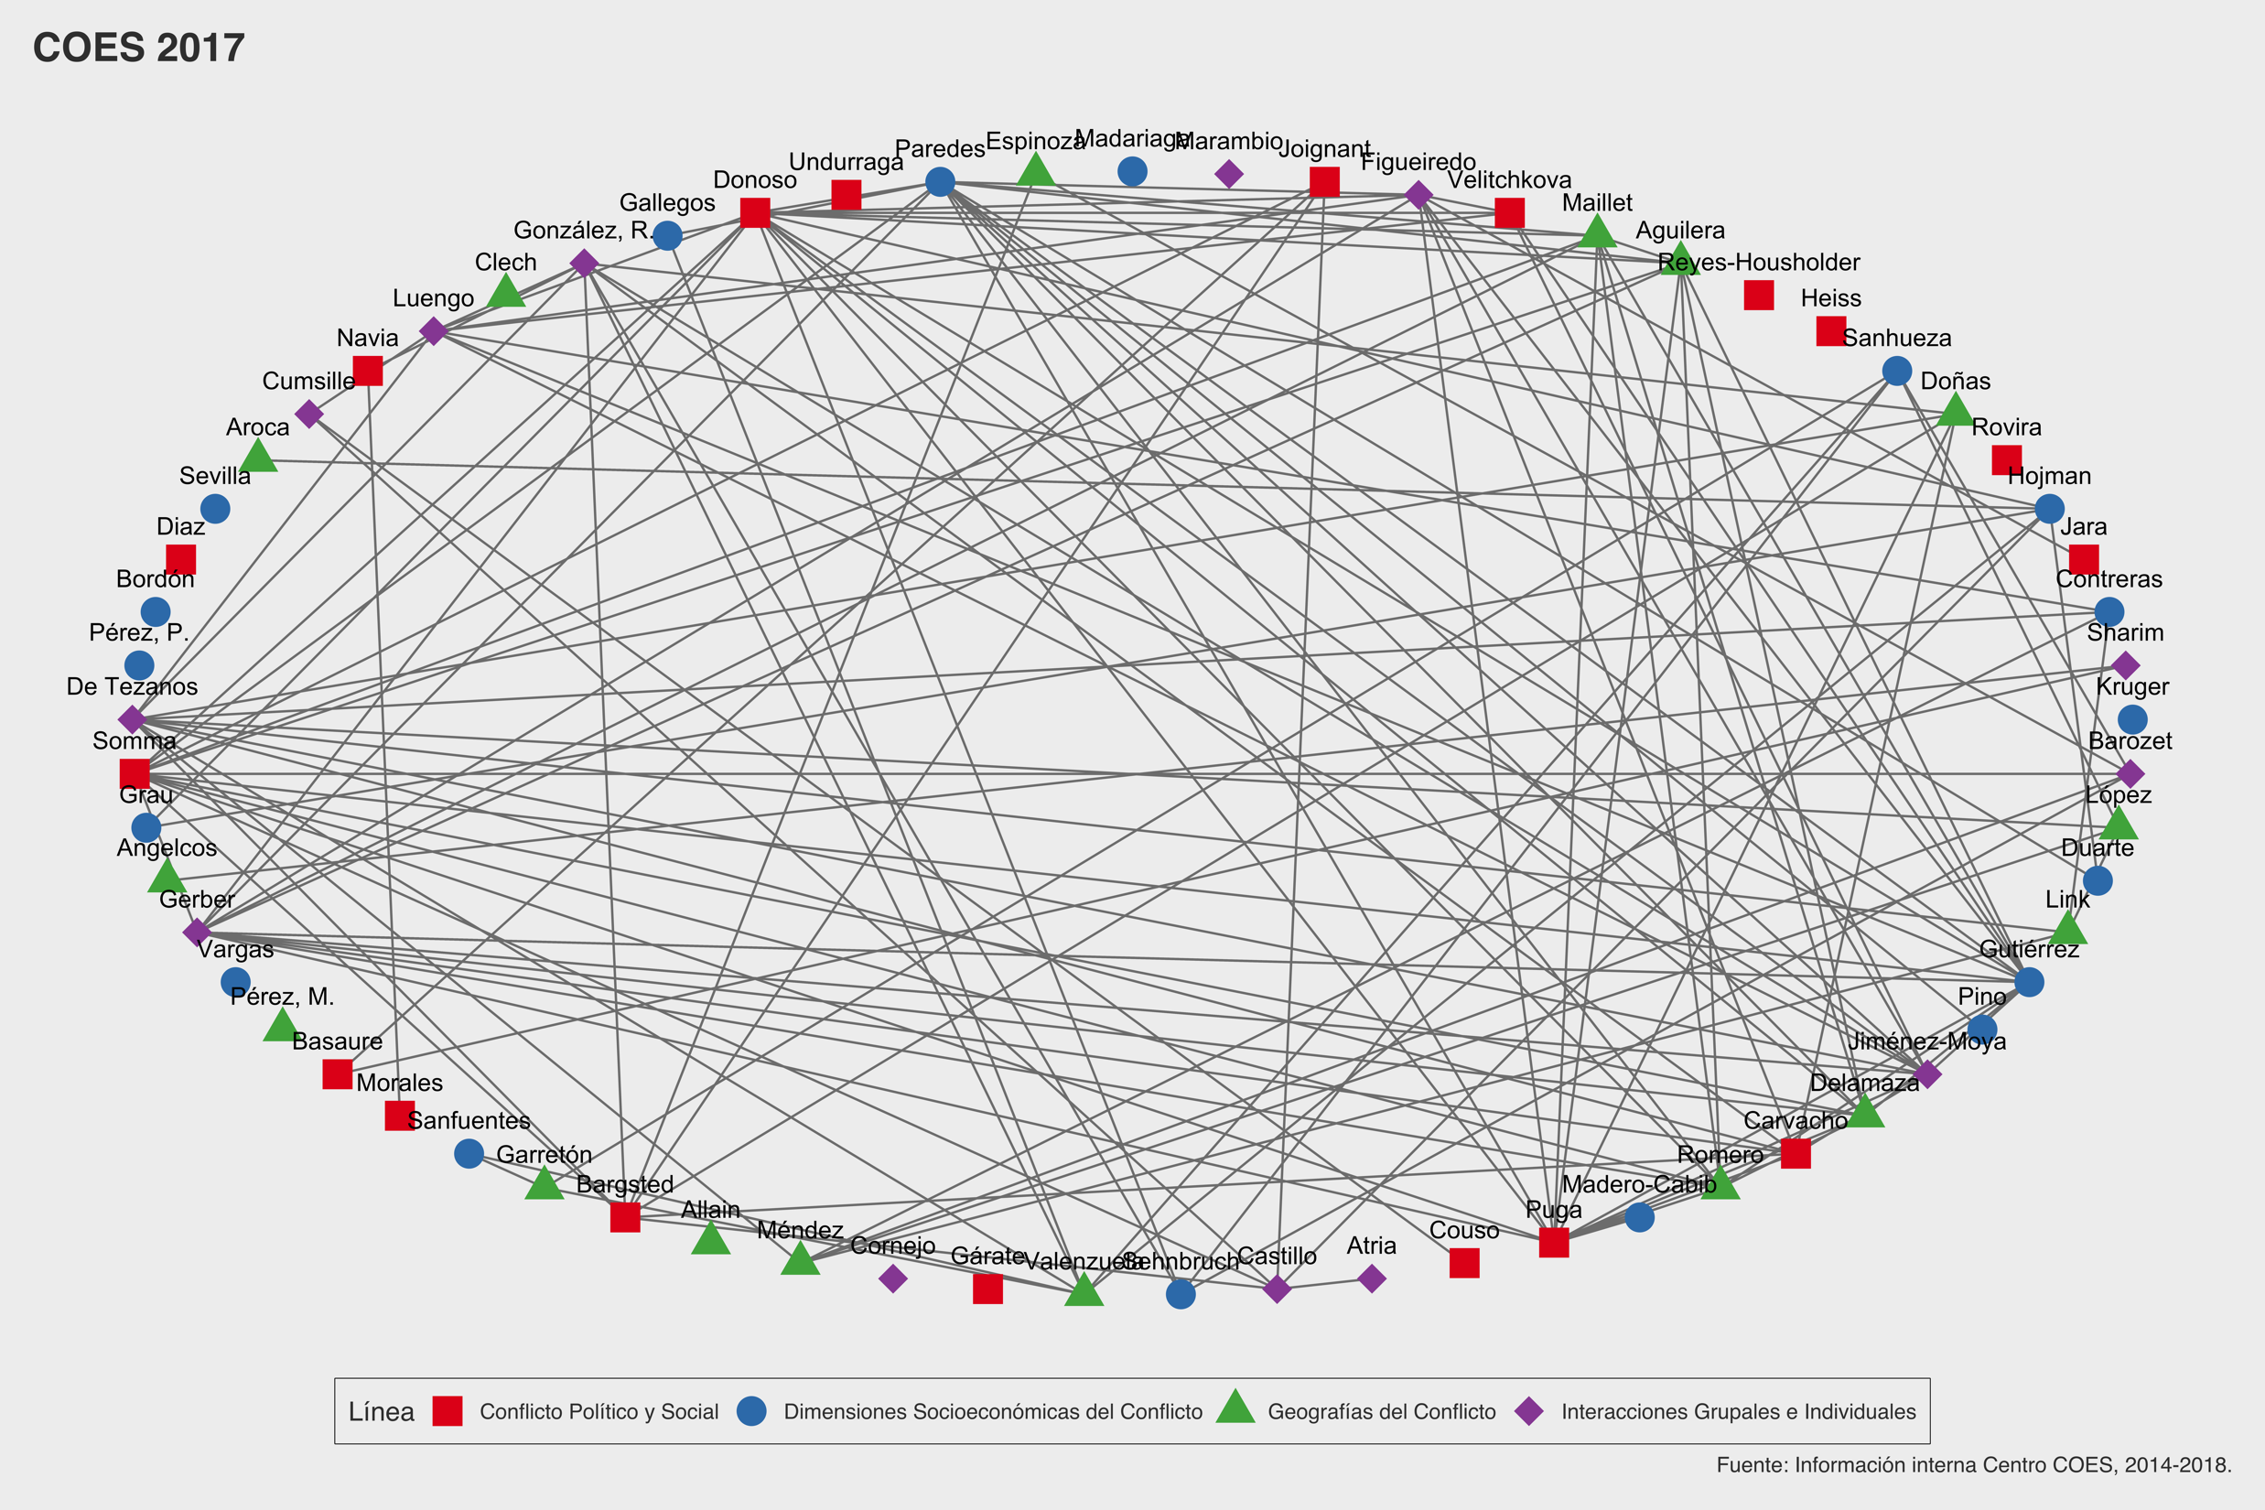
2017
65 Researchers
268 interconnections
Social and Political Conflict
Socioeconomic Dimensions of Conflict
Geographies of Conflict
Group and Individual Interactions

Slide 13
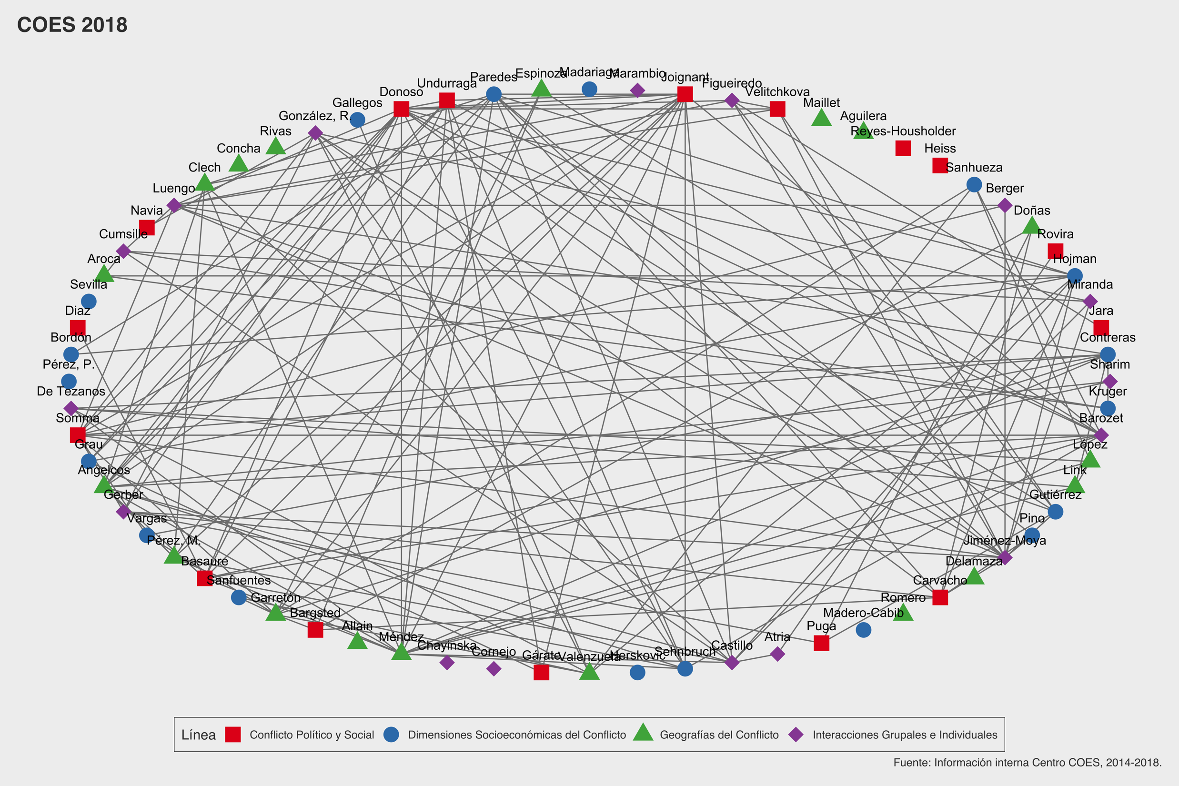
2018
68 Researchers
303 interconnections
Social and Political Conflict
Socioeconomic Dimensions of Conflict
Geographies of Conflict
Group and Individual Interactions

Slide 14
The Centre: Internal Organization
Academic board: balances academic disciplines and universities
Mini COES projects.
Promote internal interaction among COES researchers.
Balance resource allocation and responsibilities.
Flexible approach to new projects.

Slide 15
COES is a network, not a building
WE ARE HERE

Slide 16
Leverage Strategy: Human and Financial resources
Other FONDAPs
(CIIR, CIGIDEN, CEDEUS, etc.)
FONDECYT research projects
COES
Milenio and others public funds
International Funds
(LSE, FURS, CLACSO, etc)

Slide 17
Presentation Overview
2011-2013
Context of
Social Change
2013-2016
Inception Process
2016-2018
Consolidation
Process
2018-2023
Continuity Plan

Slide 18



We have a triple mandate
A. Academic Output
B. Outreach and public policy impact
C. Early career researchers
interdisciplinary; new data; national and international networks

Slide 19
A. Academic output
65
*
* August 2018
Sustained increase in publications. At the same time impact factor of those publications have also increased.

Slide 20
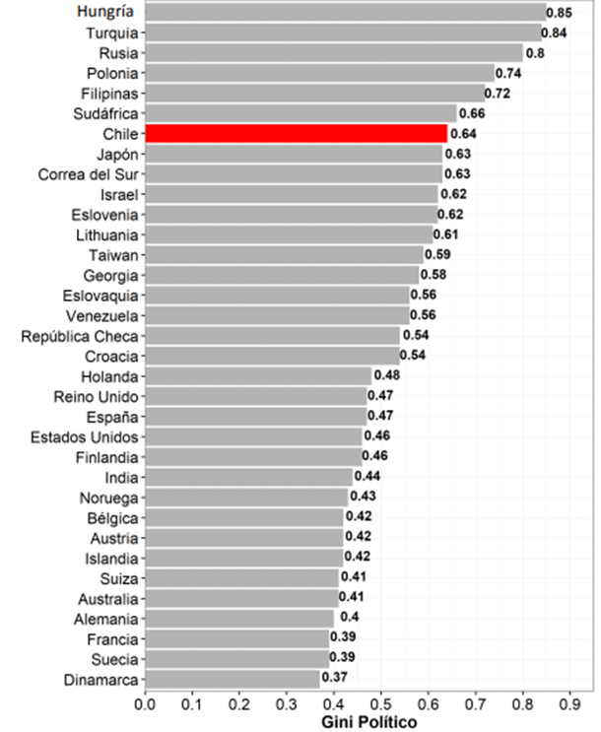
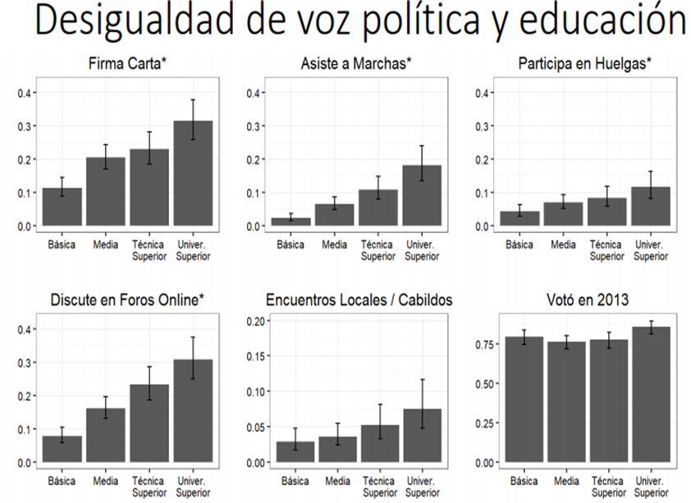
Working Model
Political Gini
Political system (L3)
(Legitimacy)
Cohesion
Conflict
Inequality and
legitimacy
Interactions (L2)
(Identity, social ties and citizenship)
Socioeconomic factors (L1)
(Inequalities)
Territorial factors (L4)
(Segregation)
Notes:
todavía muy sobrecargada .... y en lugar de mostrar esa "llave", lo que yo haría sería primero highlight las dimensiones en juego, y luego los gráficos; ejemplo en dos láminas siguientes
20

Slide 21
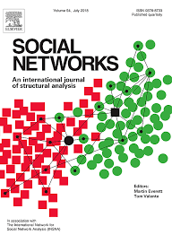
Political system (L3)
(Legitimacy)
Cohesion
Conflict
Interactions (L2)
(Identity, social ties and citizenship)
Social ties and inequality
Socioeconomic factors (L1)
(Inequalities)
Territorial factors (L4)
(Segregation)

Slide 22
Political system (L3)
(Legitimacy)
Cohesion
Conflict
Interactions (L2)
(Identity, social ties and citizenship)
Socioeconomic factors (L1)
(Inequalities)
Territorial factors (L4)
(Segregation)
Segregation and inequality
Notes:
lomismo
22

Slide 23
Political system (L3)
(Legitimacy)
Cohesion
Conflict
Social movements and territorial conflicts
Interactions (L2)
(Identity, social ties and citizenship)
Socioeconomic factors (L1)
(Inequalities)
Territorial factors (L4)
(Segregation)

Slide 24
Political system (L3)
(Legitimacy)
Cohesion
Conflict
Cohesive citizenship education
Interactions (L2)
(Identity, social ties and citizenship)
Socioeconomic factors (L1)
(Inequalities)
Territorial factors (L4)
(Segregation)

Slide 25
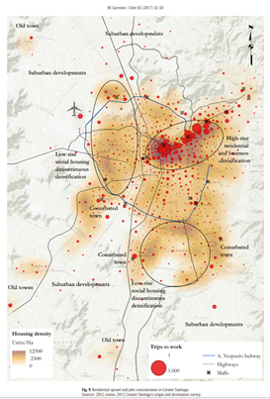
Political system (L3)
(Legitimacy)
Cohesion
Conflict
Interactions (L2)
(Identity, social ties and citizenship)
Segregation and upper middle class
Socioeconomic factors (L1)
(Inequalities)
Territorial factors (L4)
(Segregation)

Slide 26

B. Outreach & Impact In Policy Discussion
Media – Social network, YouTube, web
Social networks: we have about twice as many followers as others Fondap Centers on Facebook and Twitter (4.577 likes and 4.249 followers).
On Instagram we have twice as many followers as LSE (1.067) and our YouTube channel has more than 20.676 views.

Slide 27
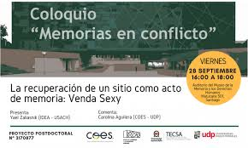
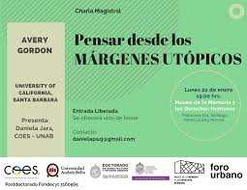
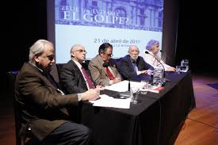
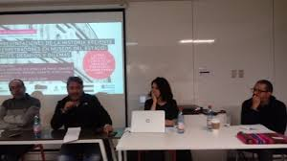
B. Outreach & Impact on Policy Discussion
COLUNGA (HUB of NGOs)
MUSEO DE LA MEMORIA Y LOS DD.HH.

Slide 28
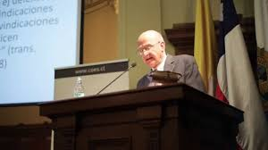
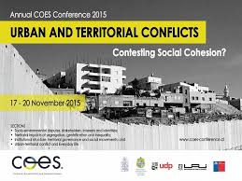
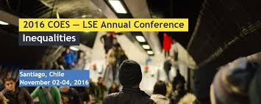


B. Outreach & Impact on Policy Discussion
Annual Conference
Legitimacy and Collective action 2014

Slide 29
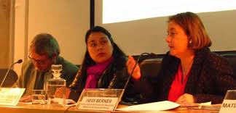



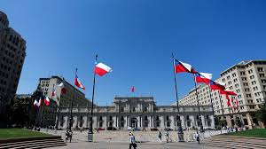
B. Outreach & Impact on Policy Discussion
Work with Ministries, Municipal Administrations and Central Government
Analysis of territorial politics in Municipalidad de Santiago
Discussion about multidimensional poverty
Analysis of Educational Reforms

Slide 30
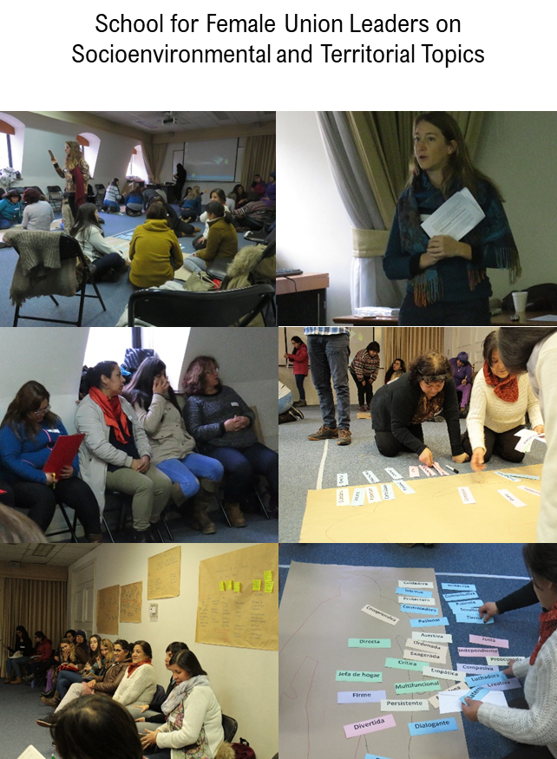
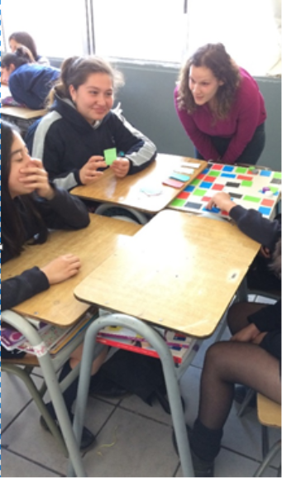
B. Outreach & Impact In Policy Discussion
Civil Society, UKAMAU, Workshop for social movements, COES in classrooms (Explora, Congreso del futuro, Impulso Docente)

Slide 31
C. Early career researchers
Annually
12 MA and 3 PhD scholarships
20 undergraduate students
Training workshops, Summer courses, methodological skills, poster sessions
Dedicated resources for students (attend conferences and field work)

Slide 32
C. Early career researchers
Mentoring programme
Carranza, PhD in LSE
Otero, PhD in U. of Amsterdam
Olivos, PhD in U. of Hong Kong
Miranda, PhD in P. U. Católica de Chile
Brito, PhD in Brown U.

Slide 33
C. Early career researchers
Competitive Annual calls for postdocs (4/70)
35% foreigners
Insertion into a network
Access to different funds
Future career development
Postdocs

Slide 34
Relevance of Academic Network
Strategic Plan
Training
Joint publications
Several researchers engaged
Harvard
UMASS
Zürich
LSE
INCASI
NOPOOR
Auckland U.
Bertelsmann Foundation (Cohesion Radar)

Slide 35
Presentation Overview
2011-2013
Context
of Social Change
2013-2016
Inception Process
2016-2018
Consolidation
Process
2018-2023
Continuity Plan

Slide 36
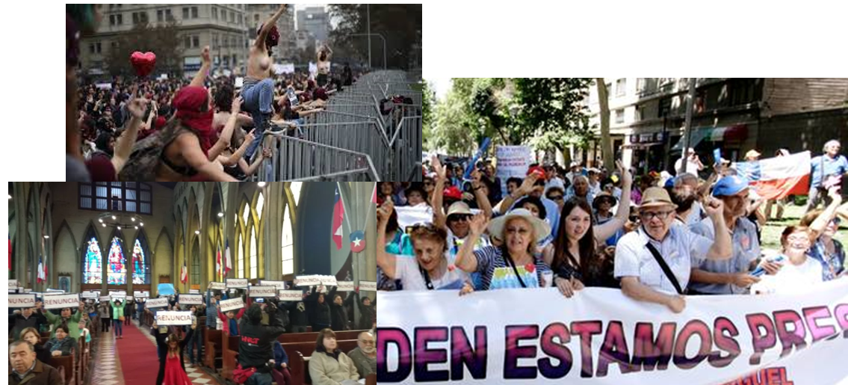
New context… new social movements
Feminist movements
Territorial movements
Pension system (AFP)

Slide 37
Lack of trust in elites, corruption
Political and economic elites

Slide 38
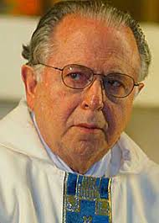
Elites: Crisis in the catholic church
Pope visit in Iquique (2018)

Slide 39
Intense debate on migration…

Slide 40
COES 2.0

Slide 41
COES 2.0: Overview
New organization.
Integrated Data Platform.
Study of Social Change.
Research in action: application to public policies.
Improve our national and international networks.
Balance disciplinary and interdisciplinary publications.
Open Science.

Slide 42
1. Original
Organization

Slide 43
New Organization

Slide 44
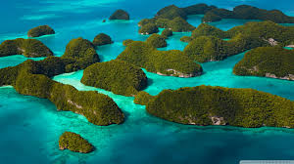
2. Integrated Data Platform
An archipelago of data islands to be linked into a coherent whole
Quantitative data
Qualitative data
Spatial data
Longitudinal data

Slide 45
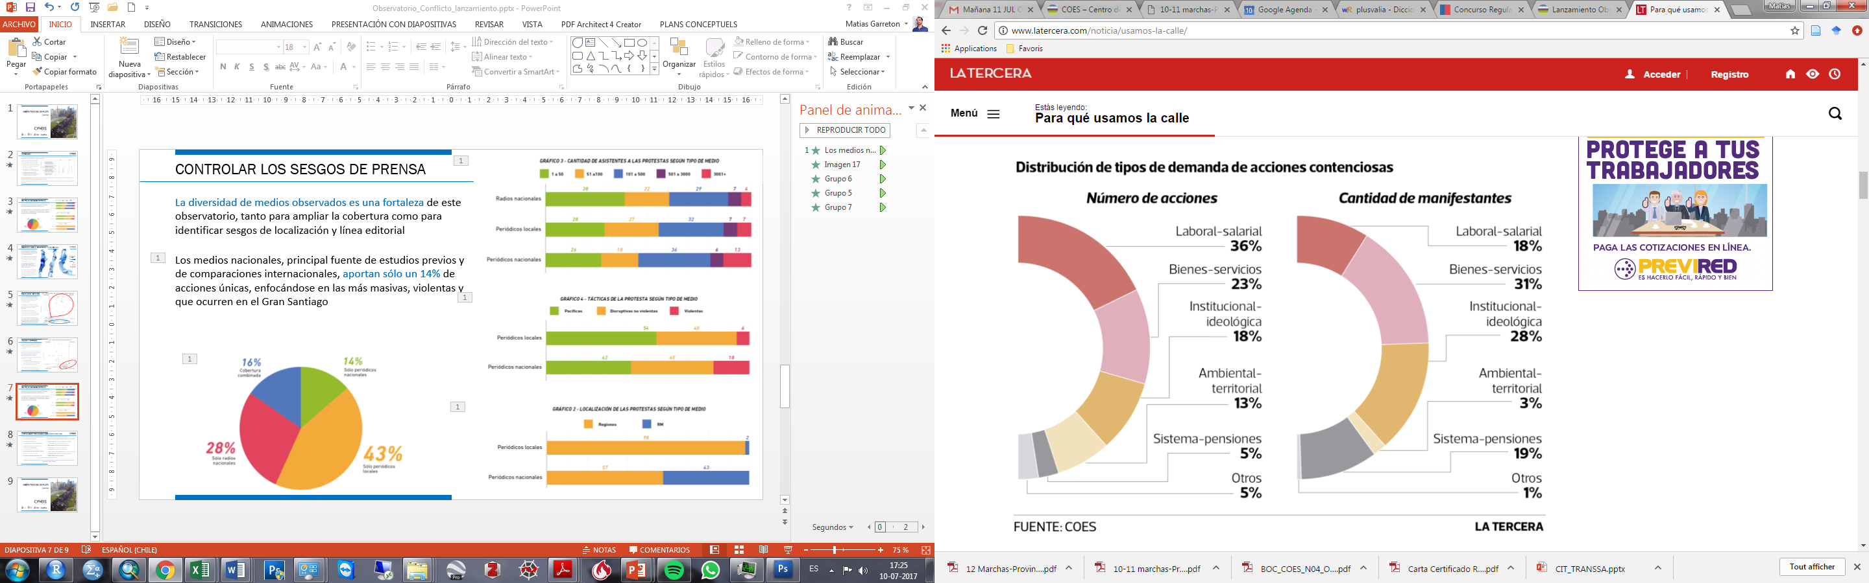
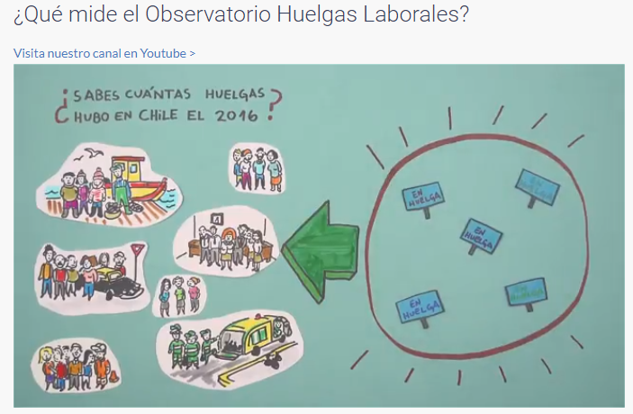
2. Integrated Data Platform
Quantitative data from Observatories of Strikes, Conflicts and Cohesion

Slide 46
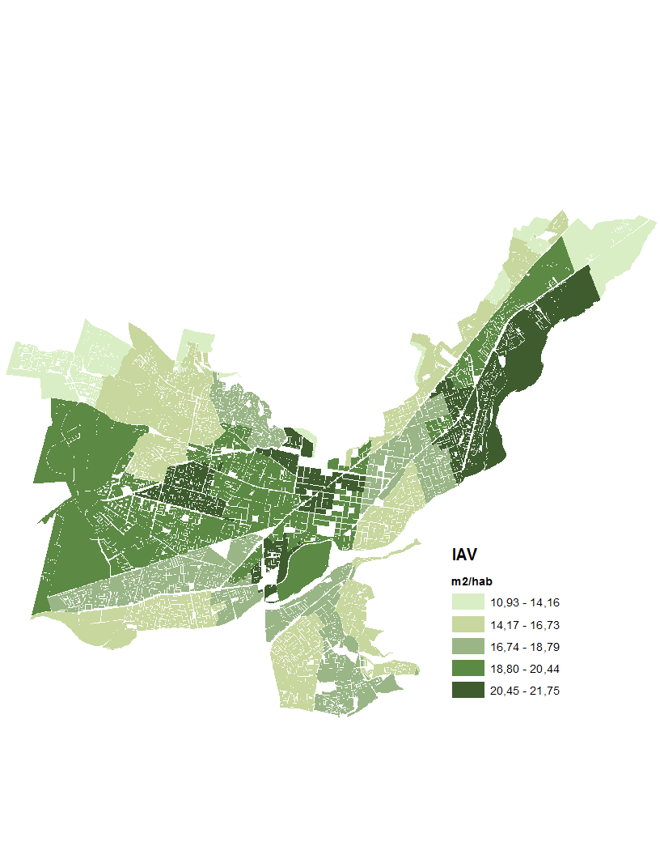
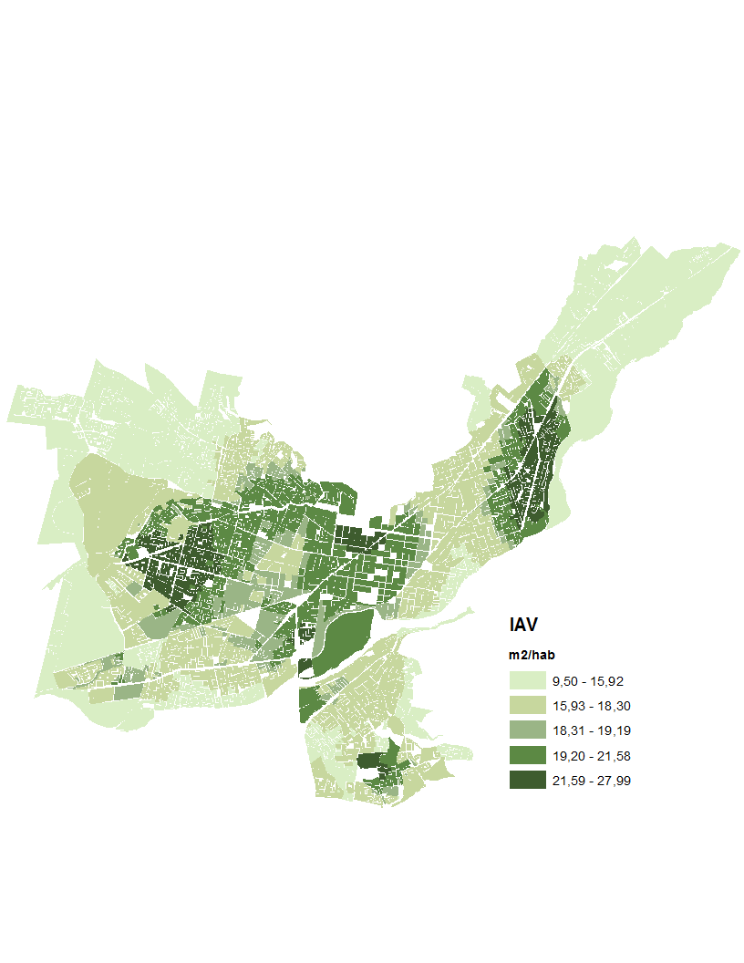
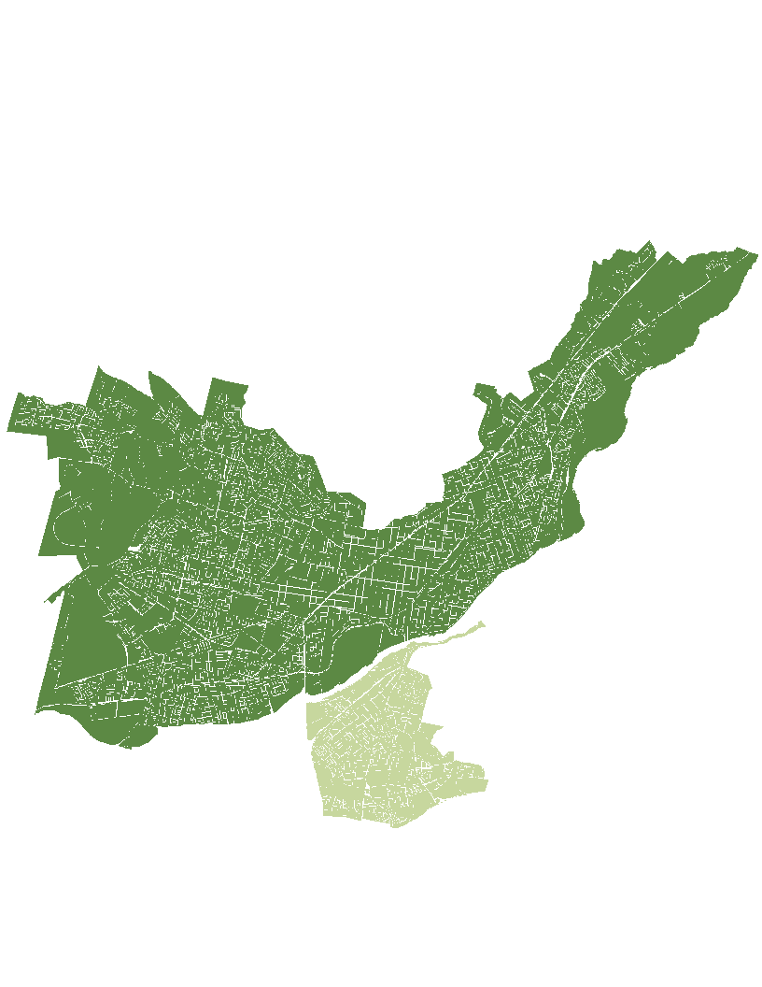
2. Integrated Data Platform
NEIGHBORHOOD ASSOCIATION
Spatial data: Territorial Wellbeing Indicator
Block
Neighborhood A.
Municiplity
City
BLOCK
MUNICIPALITY
CITY
17,85 M2/HAB
TEMUCO
18,02 m2/hab
PADRE LAS CASAS
16,8 m2/hab

Slide 47
2. Integrated Data Platform
Longitudinal data: ELSOC
2016
2017
2018
2019
2020
2021
2022
2023
2024
Muestra 1
Ola 1
Ola 2
Ola 3
Ola 4
Ola 5
Ola 6
Ola 7
Ola 8
Ola 9
Ola 1
Ola 2
Ola 3
Ola 4
Ola 5
Ola 6
Ola 7
Muestra 2

Slide 48
3. Dynamic Perspective of Social Change:
How do (inequality), conflict and cohesion develop over time?
What determines these changes?
Goal → include dynamic aspects in our research lines to understand better complex aspects of social change.
Examples:
Using longitudinal and time series data: ELSOC, Observatories
Analysing socioeconomic administrative data over time and over the life-cycle
Analysing political changes: elites, perceptions of legitimacy, the impact of structural reforms

Slide 49
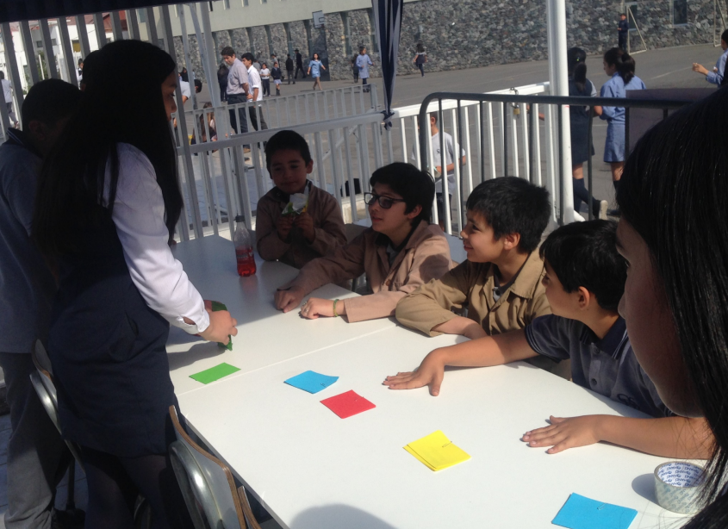
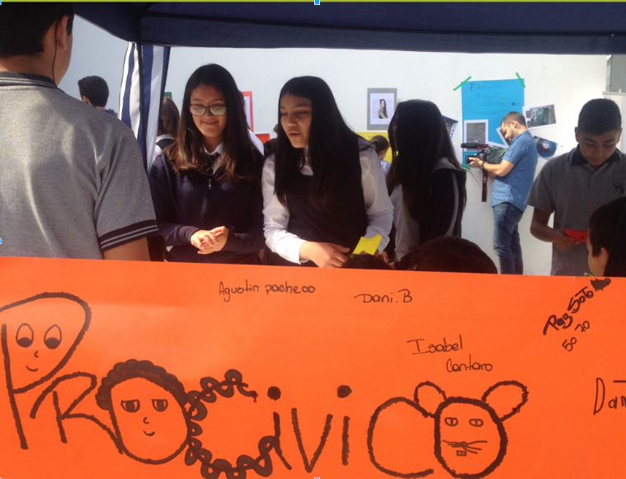
4. Research in Action: Application to Public Policies
New unit of public policy → interaction with policy makers
CIT, GobLab-UAI, Gob. School UC
Applied research projects:
ProCívico (interventions)
Migration, gender, education

Slide 50
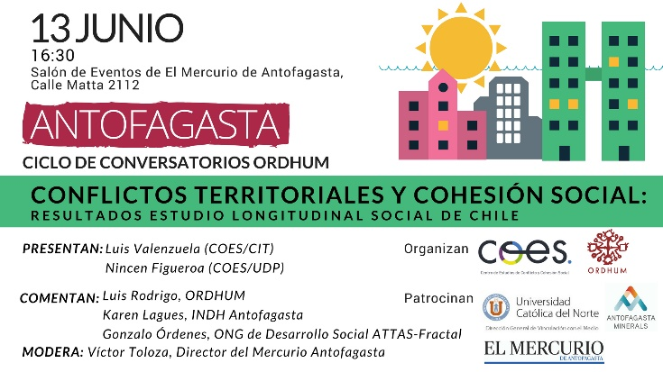
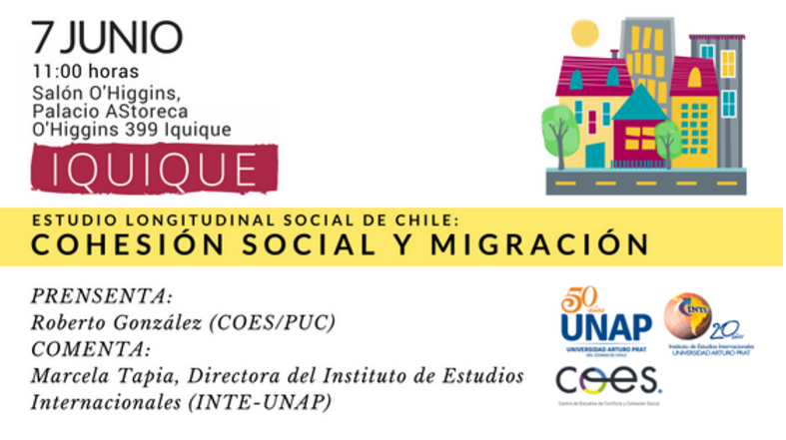
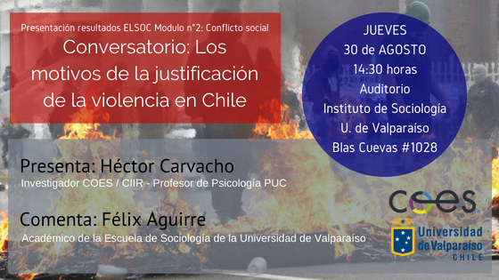
5. Improve our National/International Network
Network of universities:
Regional Universities (dissemination and collaboration)
LA: joint projects, Observatory of the quality of Employment in Latin America

Slide 51
6. Disciplinary and Interdisciplinary excellence
Maintain our mixed strategy defined in conjunction with the scientific committee:
Journals: disciplinary and multidisciplinary.
Books.
English and Spanish.
Increase the number of publications in Q1 of impact factors.

Slide 52
7. Engage COES into Open Science
Define and promote an internal policy for:
Reproducibility.
Access to data.
Transparency of analysis, coding.
Pre-prints publications.
Access via Web.

Slide 53
Thank you

Slide 54
COES beyond 10 years?
Mixed strategy to fund COES going forwards:
Conicyt
Host universities: based on the strong institutional commitments
Regional Universities
International comparative (and longitudinal) studies
Open to new contexts
Direct influence on public policy

Slide 55


